Slide 1

Fashion-MNIST Classification: ANN vs CNN
A comparative analysis of neural network architectures for image classification

Slide 2
The Challenge
Introduction & Objective
The Challenge: To accurately categorize grayscale images of clothing of the Fashion-MNIST dataset.
The Dataset: 70000 28x28 images in 10 categories (T-shirts, Trousers, Sneakers, etc.).
The Objective:
Implement two different neural network architectures:
  Artificial Neural Network (ANN)
  Convolutional Neural Network (CNN)
Train and test both models.
Compare their performance to see which is better, and why.

Slide 3
Data Preprocessing
01
02
Loading
Splitting
Used torchvision to load the 60,000 training images and 10,000 test images.
The 60k training images were split:
48,000 (80%) for Training
12,000 (20%) for Validation (to check our work)
03
04
Normalization
Data Loaders
ToTensor(): Converted images to PyTorch Tensors.
Used DataLoader with a batch size of 64.
Normalize((0.5,), (0.5,)): Scaled pixel values from [0, 1] to [-1, 1] for faster training.

Slide 4

Model 1
The "Simple" ANN
Architecture:
A standard Multi-Layer Perceptron (MLP).
How it works:
Key weakness:
The 28x28 image is flattened into 1D a 784 pixel vector.
By flattening the image, it loses all spatial information. It doesn't know which pixels are next to each other.
This is transmitted through 3 Fully-Connected layers.
Topology:
Linear(784, 128) -> ReLU -> Linear(128, 64) -> ReLU -> Linear(64, 10)

Slide 5

Model 2
The "Smart" CNN
Architecture:
Key Strength:
A Convolutional Neural Network, designed for images.
It preserves spatial information and learns features hierarchically.
Topology:
How it works:
Conv2d (32 filters) -> MaxPool
Feature Extractor: Uses 2D "filters" to scan the image for patterns (edges, corners, etc.).
Conv2d (64 filters) -> MaxPool
Classifier: A standard linear layer at the end to make the final decision.
Flatten
Linear(3136, 128) -> Dropout(0.25) -> Linear(128, 10)

Slide 6
Training Setup
Common setup for both models:
Loss Function
Optimizer
Learning Rate
nn.CrossEntropyLoss (Standard for multi-class classification).
optim.Adam (A fast, efficient optimizer).
0.001
Epochs
Environment
10
Trained using PyTorch on a cuda (GPU) device for acceleration.

Slide 7
Results: The Numbers
A clear winner emerged after evaluating on the 10,000-image test set.
Model
Test Accuracy
ANN (Simple)
87.61%
CNN (Smart)
91.99%
The CNN is 4.38% more accurate. Now, let's look at why.

Slide 8
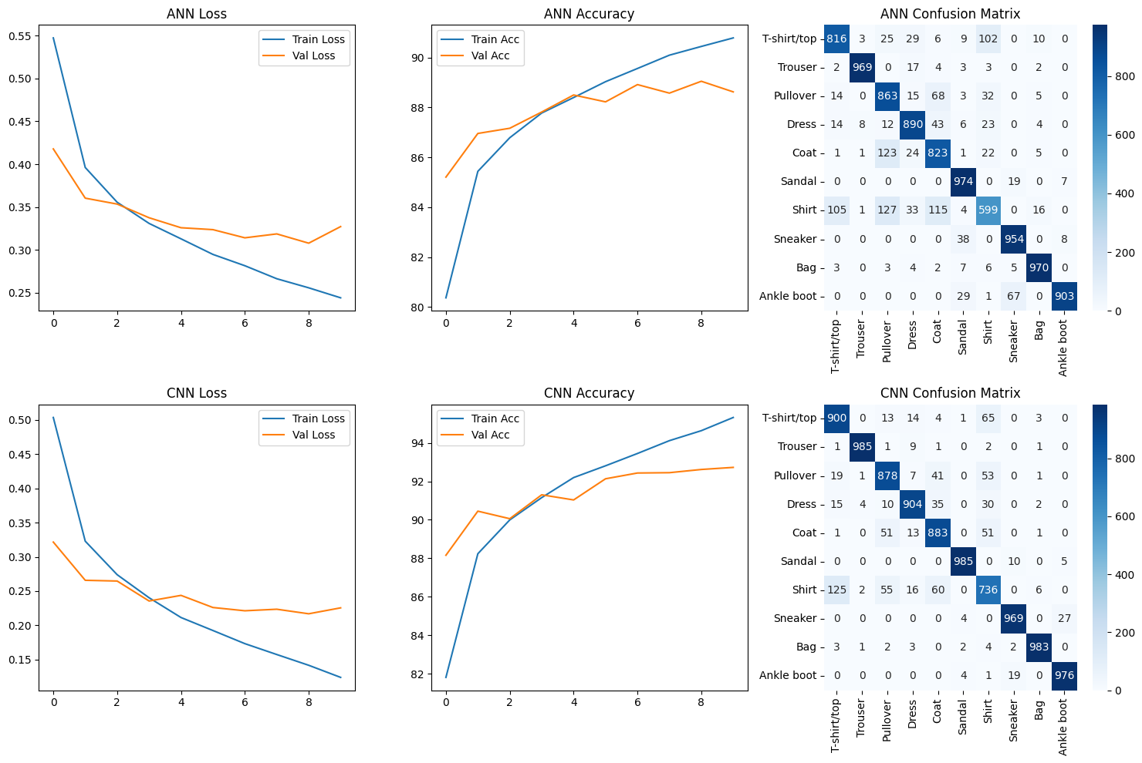
Results: Loss & Accuracy Curves
ANN (Top Row):
The Training Loss (blue) goes down.
The Validation Loss (orange) flattens and starts to rise.
This is classic overfitting. The model just memorized the training data and didn't learn to generalize.
CNN (Bottom Row):
The curves for Training and Validation track each other very closely.
This is a healthy model. It learned general patterns, which is why it performed better on unseen test data.

Slide 9
Analysis: The Confusion Matrix
(You would show the results.png plot here, focusing on the two matrices)
The confusion matrix shows us where the model got confused.
ANN:
CNN:
Look at the row for 'Shirt' (index 6).
Look at the same 'Shirt' row (index 6).
It misclassified 115 Shirts as Coats (index 4) and 127 Shirts as T-shirts (index 0).
Misclassifications are much lower (e.g., only 60 Shirts as Coats).
It's very confused.
The diagonal is much darker, meaning more correct predictions.

Slide 10


The Key Insight: Why the CNN Won
ANN:
CNN:
Flattens the image into a long list.
Scans the 2D image for features.
It sees: [pixel, pixel, pixel, ...]
It sees: "This has a collar," "This has buttons," "This has long sleeves."
It can't tell the difference between a 'Shirt', 'Coat', and 'Pullover' because they all have a similar "global average" of pixels.
It builds a spatial understanding of the object, which is why it can tell the similar items apart.

Slide 11
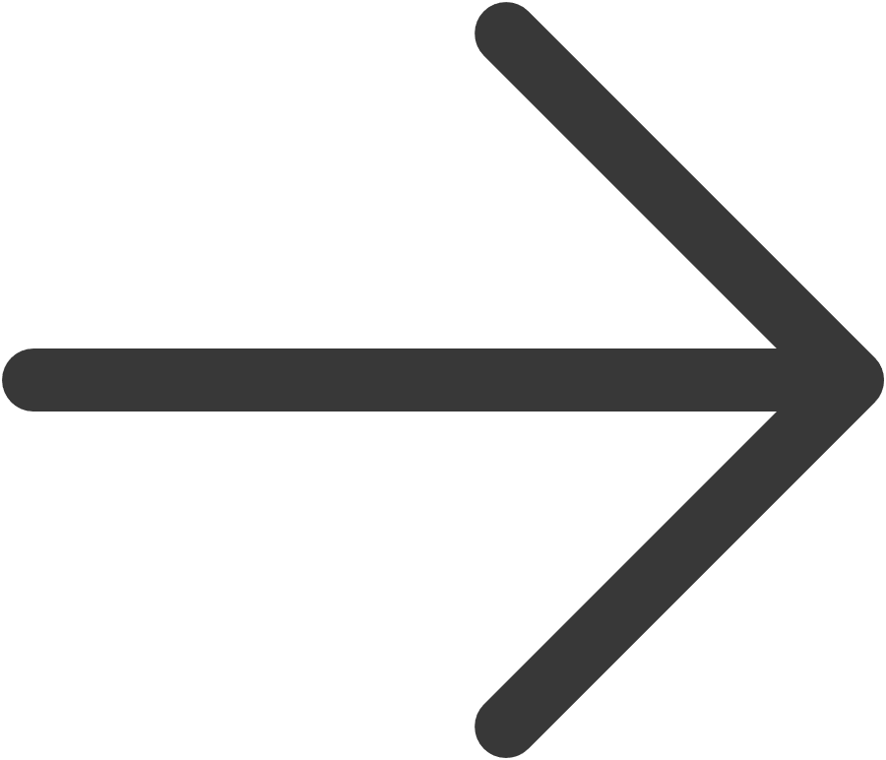
Conclusion & Future Work
The CNN is unequivocally superior for image classification, primarily due to its spatial feature extraction, a capability lacking in the ANN.
Data Augmentation
Implement RandomHorizontalFlip and RandomRotation to expand training data and improve model robustness.
LR Scheduler
Apply a Learning Rate Scheduler to automatically change the learning rate to give results that are more fine-tuned.
Deeper Model
Add more Batch Normalization or convolutional layers, or use more convolutional layers to improve model capacity.

Slide 12
Thank You
Questions?

